Slide 2
Questions we want to answer
To what degree does alcohol consumption affect students?
Should the legal drinking age be changed?
What factors, if any, cause increased alcohol consumption for students?

Slide 3
Context for the data
Data was collected from two Portuguese schools
Data contains grades collected from Maths class
Students are scored on a scale of 0-20, where 10+ is passing
The legal drinking age in Portugal is 18

Slide 4
Response Variables
Student Performance
Health
Absences
Grades
Failed classes
Alcohol consumption
On weekdays
On weekends

Slide 5
Explanatory Variables for Student Performance
School
Age
Family Size
Parental Status
Parent’s education level
Study time
Academic support
Plans of higher education
Relationship with family
Alcohol consumption on weekdays
Alcohol consumption on weekends
Access to internet at home

Slide 6
Explanatory Variables for Alcohol consumption
Gender
Age
Family Size
Parental Status
Plans of higher education
Internet access at home
Relationship status
Relationship with family
Free time
Time spent going out

Slide 7
Methods
Models briefly mention

Slide 8
Models Results (Accuracy)
(Including hyperparameter tuning)
 | Logistics Regression | SVM | Random Forest | Gradient Boosting
Y1 | 0.40 | 0.34 | 0.36 | 0.32
Y2 | 0.27 | 0.28 | 0.24 | 0.17
Y3 | 0.08 | 0.12 | 0.11 | 0.17
Y4 | 0.82 | 0.82 | 0.82 | 0.77
Y5 | 0.75 | 0.75 | 0.77 | 0.77
Y6 | 0.45 | 0.37 | 0.45 | 0.46

Slide 9
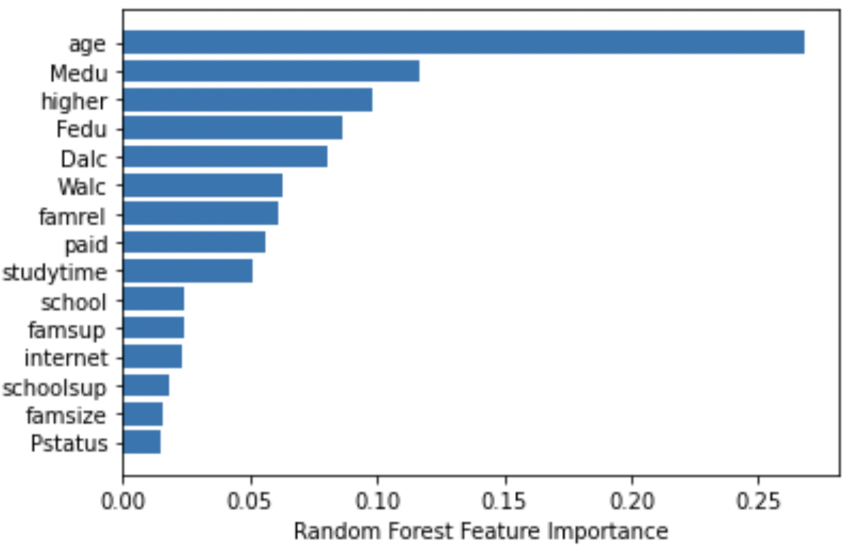
Feature Importance from Random Forest (Y4)

Slide 10
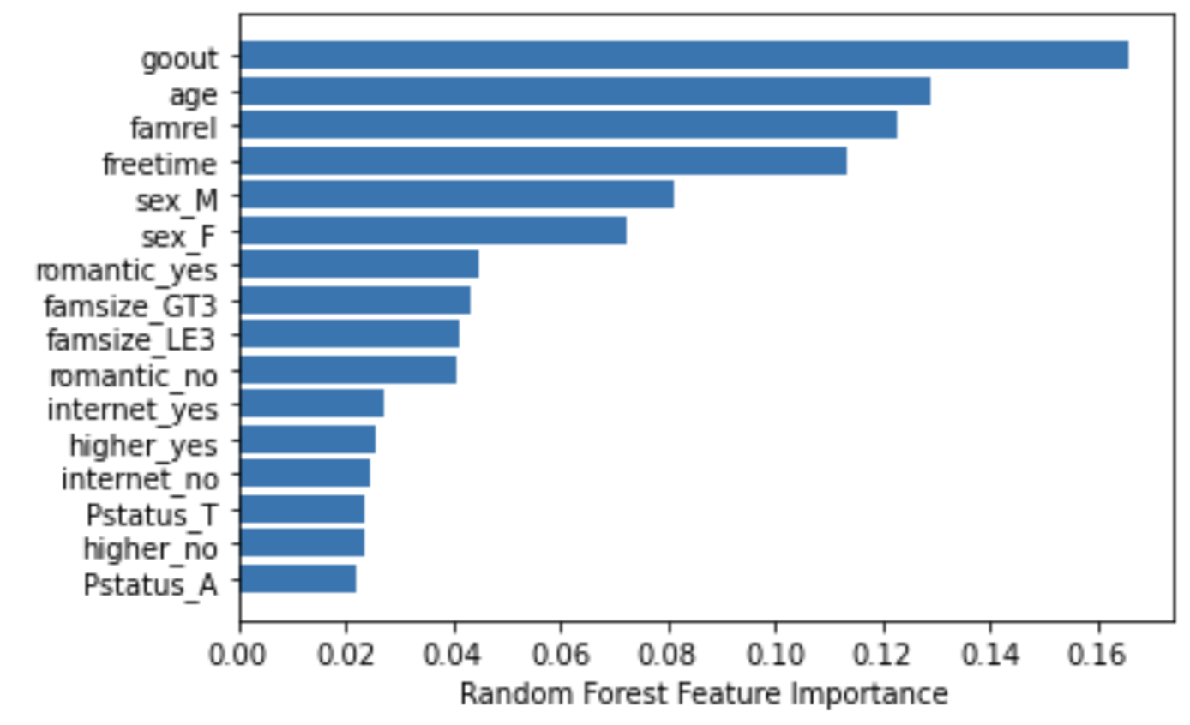
Feature Importance from Random Forest (Y5)

Slide 11
Conclusion
Y4 and Y6 we can conclude that …
For the rest of Ys we were not able to fit the right models
It’s possible that our covaritates did not have much relation to these ys

